Slide 1
Human Activity Recognition with Smartphones
Zhou Fang & Jiale Liu
03/20/2018

Slide 2
Background:
Motivation:
Activity recognition is an important technology in pervasive computing because it can be applied to many real-life, human-centric problems such as eldercare and healthcare.
Goal:
The goal of activity recognition is to recognize common human activities in real life settings. Accurate activity recognition is challenging because human activity is complex and highly diverse.
Our goal in this project is finding an appropriate approach to classify indoor activities by the use of Human Activity Recognition Using Smartphones Data Set (HAR). This application scenario can be monitoring the indoor activities of elders, including some daily activities such as walking, sitting, laying, standing and so on.

Slide 3
Dataset
Name of dataset:
Human Activity Recognition Using Smartphones Data Set (HAR)
(https://github.com/guillaume-chevalier/LSTM-Human-Activity-Recognition)
Description:
Recording a group of 30 volunteers within an age bracket of 19-48 years.
Performing six activities (walking, walking upstairs, walking downstairs, sitting, standing, laying)
Wearing a smartphone (Samsung Galaxy S II) on the waist.
Using its embedded accelerometer and gyroscope.
Capturing 3-axial linear acceleration and 3-axial angular velocity at a constant rate of 50Hz.
Notes:
Description:
The experiments have been carried out with a group of 30 volunteers within an age bracket of 19-48 years. Each person performed six activities (WALKING, WALKING_UPSTAIRS, WALKING_DOWNSTAIRS, SITTING, STANDING, LAYING) wearing a smartphone (Samsung Galaxy S II) on the waist. Using its embedded accelerometer and gyroscope, we captured 3-axial linear acceleration and 3-axial angular velocity at a constant rate of 50Hz. The experiments have been video-recorded to label the data manually. The obtained dataset has been randomly partitioned into two sets, where 70% of the volunteers was selected for generating the training data and 30% the test data.
The sensor signals (accelerometer and gyroscope) were pre-processed by applying noise filters and then sampled in fixed-width sliding windows of 2.56 sec and 50% overlap (128 readings/window). The sensor acceleration signal, which has gravitational and body motion components, was separated using a Butterworth low-pass filter into body acceleration and gravity. The gravitational force is assumed to have only low frequency components, therefore a filter with 0.3 Hz cutoff frequency was used. From each window, a vector of features was obtained by calculating variables from the time and frequency domain.
Attribute Information:
For each record in the dataset it is provided: - Triaxial acceleration from the accelerometer (total acceleration) and the estimated body acceleration. - Triaxial Angular velocity from the gyroscope. - A 561-feature vector with time and frequency domain variables. - Its activity label. - An identifier of the subject who carried out the experiment.

Slide 4
Attribute Information:
Raw Signals
tBodyAcc-XYZ
Derivative Unit
tBodyAccJerk-XYZ
tAcc-XYZ
Noise Filter
Low Pass Filter
tGravityAcc-XYZ
tGyro-XYZ
Noise Filter
tBodyAcc-XYZ
Derivative Unit
tBodyAcc-XYZ
Figure 1. The pre-process of the raw signals
The set of variables that were estimated from blue box signals are: mean, std, max, min, etc.
Notes:
The features selected for this database come from the accelerometer and gyroscope 3-axial raw signals tAcc-XYZ and tGyro-XYZ. These time domain signals (prefix 't' to denote time) were captured at a constant rate of 50 Hz. Then they were filtered using a median filter and a 3rd order low pass Butterworth filter with a corner frequency of 20 Hz to remove noise. Similarly, the acceleration signal was then separated into body and gravity acceleration signals (tBodyAcc-XYZ and tGravityAcc-XYZ) using another low pass Butterworth filter with a corner frequency of 0.3 Hz.
Subsequently, the body linear acceleration and angular velocity were derived in time to obtain Jerk signals (tBodyAccJerk-XYZ and tBodyGyroJerk-XYZ). Also the magnitude of these three-dimensional signals were calculated using the Euclidean norm (tBodyAccMag, tGravityAccMag, tBodyAccJerkMag, tBodyGyroMag, tBodyGyroJerkMag).
Finally a Fast Fourier Transform (FFT) was applied to some of these signals producing fBodyAcc-XYZ, fBodyAccJerk-XYZ, fBodyGyro-XYZ, fBodyAccJerkMag, fBodyGyroMag, fBodyGyroJerkMag. (Note the 'f' to indicate frequency domain signals).
These signals were used to estimate variables of the feature vector for each pattern:
'-XYZ' is used to denote 3-axial signals in the X, Y and Z directions.
tBodyAcc-XYZ
tGravityAcc-XYZ
tBodyAccJerk-XYZ
tBodyGyro-XYZ
tBodyGyroJerk-XYZ
tBodyAccMag
tGravityAccMag
tBodyAccJerkMag
tBodyGyroMag
tBodyGyroJerkMag
fBodyAcc-XYZ
fBodyAccJerk-XYZ
fBodyGyro-XYZ
fBodyAccMag
fBodyAccJerkMag
fBodyGyroMag
fBodyGyroJerkMag
The set of variables that were estimated from these signals are:
mean(): Mean value
std(): Standard deviation
mad(): Median absolute deviation
max(): Largest value in array
min(): Smallest value in array
sma(): Signal magnitude area
energy(): Energy measure. Sum of the squares divided by the number of values.
iqr(): Interquartile range
entropy(): Signal entropy
arCoeff(): Autorregresion coefficients with Burg order equal to 4
correlation(): correlation coefficient between two signals
maxInds(): index of the frequency component with largest magnitude
meanFreq(): Weighted average of the frequency components to obtain a mean frequency
skewness(): skewness of the frequency domain signal
kurtosis(): kurtosis of the frequency domain signal
bandsEnergy(): Energy of a frequency interval within the 64 bins of the FFT of each window.
angle(): Angle between to vectors.
Additional vectors obtained by averaging the signals in a signal window sample. These are used on the angle() variable:
gravityMean
tBodyAccMean
tBodyAccJerkMean
tBodyGyroMean
tBodyGyroJerkMean

Slide 5
Attribute Information (Continue):
Real features:
All features are normalized and bounded within [-1, 1].
The UCI dataset has done the pre-process the raw signals already.
The features we got from UCI dataset are the numeral.
Summary of dataset
Items | The number of items
Number of Instances | 10299
Number of Training set | 7352
Number of Test set | 2947
Number of Attributes | 561
Table 1: The capacity of dataset

Slide 6
Approach
MLP (Multi-layer perceptron)
MLP model
Output layer
(6*1 of six classes)
Soft max classifier
Hidden layer
Hidden linear layer
(512 units)
Relu
Acceleration
X,Y,Z
Gyro
X,Y,Z
Input layer
(561 numeral features
from two sensors)
…
Figure 4. The figure if MLP modeling

Slide 7
Experiment
MLP
Parameter setting
Result
Best test accuracy is 95.555% achieved at epoch 31. Test loss is 0.13719.
Items | Explanation of items
Hidden dimension | 512
Mini batch size | 32
Optimizer | SGD (lr=0.0009, momentum=0.9)
Criterion function | CrossEntropy
Table 2. Parameter setting of MLP

Slide 8
Approach
1. RNN with LSTM
LSTM model
Predict label
Output layer
(Six classes probabilities)
…
Recurrent Hidden layer (LSTM)
Input layer
(561 numeral data)
…
Input 561 features

Slide 9
Experiment
LSTM
Parameter setting
Result
Best test accuracy is 95.623% achieved at epoch 36.
Items | Explanation of items
Hidden dimension | 512
Mini batch size | 32
Dropout | 0.5
Optimizer | SGD (lr=0.0016, momentum=0.9)
Criterion function | CrossEntropy
Table 2. Parameter setting of LSTM
Notes:
The result:
After 50 epochs, the loss of training set is 0.08773, accuracy of the training set is 0.97198, the loss of test set is 0.13639, accuracy of test set is 0.95080

Slide 10
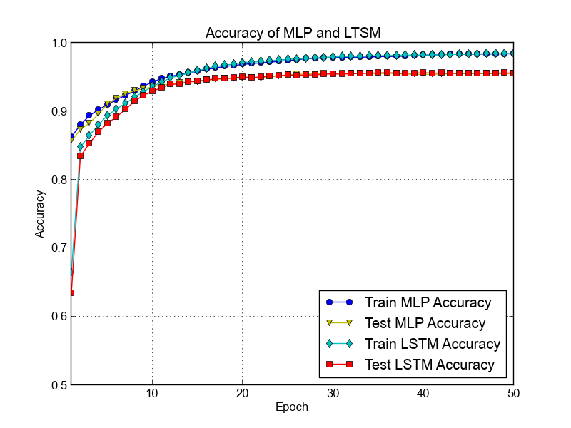
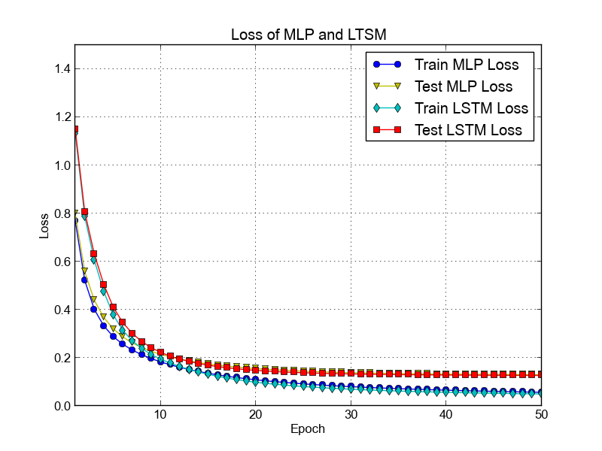
Result Analysis
MLP & LSTM
Figure 6. Accuracy and loss of MLP & LSTM
Notes:
At the first 30 epochs, the performance of MLP is better than LSTM.
After 30 epochs, the performance of MLP is stable at 95% accuracy, LSTM is also arrive at 95% accuracy.

Slide 11
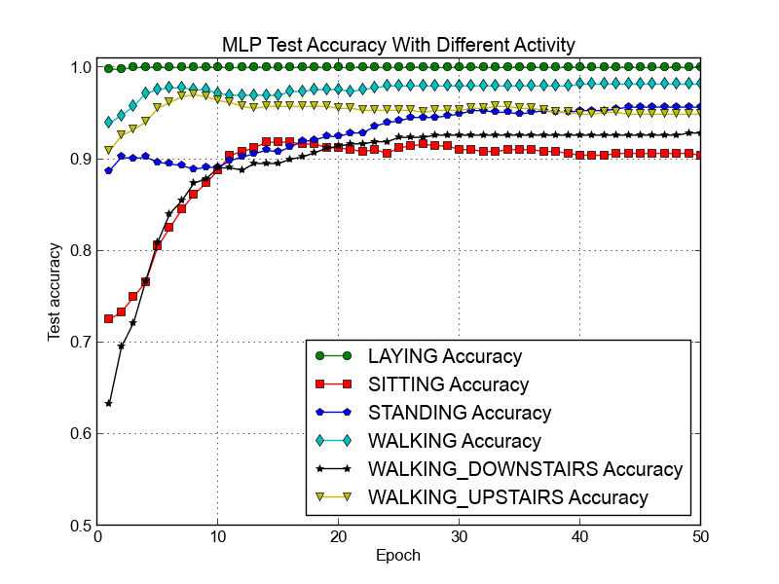
Result Analysis
MLP and LSTM test accuracy by different classes
Figure 10. Comparison between MLP & LSTM of each activity

Slide 12
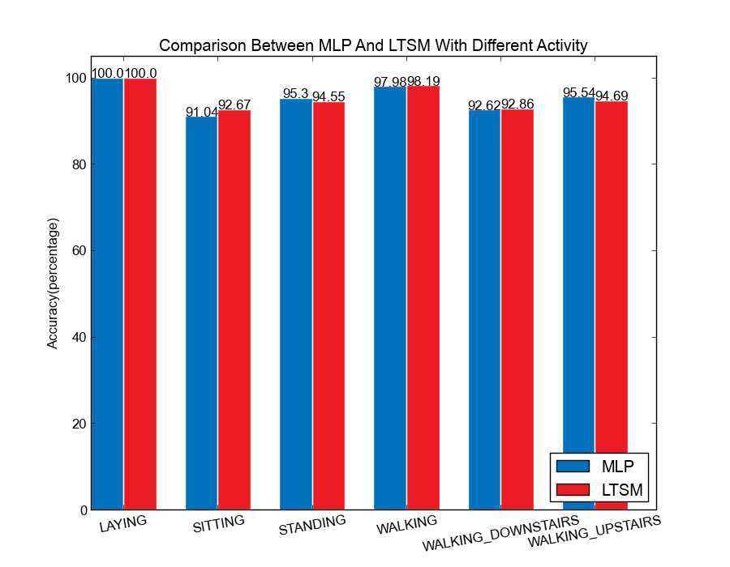
Result Analysis
Comparison between MLP and LSTM by different classes
Figure 10. The comparison between MLP & LSTM of each activity

Slide 13
Improvement
Feature Selection by Importance in RandomForest
292 features selected
Table 4. Comparison of feature selection results
Notes:
Form the table 4, we can see that, the accuracy is nearly to the original method without feature selection. The model is also show a good performance with only features rather than 561 features which will converge more faster with less features.

Slide 14
Improvement
Feature Selection by F-score
400 features selected
Notes:
Form the table 4, we can see that, the accuracy is nearly to the original method without feature selection. The model is also show a good performance with only features rather than 561 features which will converge more faster with less features.

Slide 15
Comparison with other methods reference: K. Nakano and B. Chakraborty, “Effect of dynamic feature for human activity recognition using smartphone sensors” 2017 IEEE 8th International Conference.
Activity | CNN | K-NN | MLP | LSTM | Importance MLP | Importance LSTM | F-score MLP | F-score LTSM
Walking | 0.9980 | 0.9778
Upstairs | 0.9703 | 0.9002
Downstairs | 0.9905 | 0.7857
Sitting | 0.7739 | 0.9304
Standing | 0.8909 | 0.9304
Laying | 0.8100 | 0.9944
Overall | 0.9056 | 0.9012
Others’ methods
Our methods
Table 3. The comparison with other methods

Slide 16
Conclusion:
Our methods:
Our two method LSTM and MLP has already showed a good performance with 561 features comparing with other methods such as KNN and CNN.
They arrived 0.9566 and 0.9572 accuracy on test set separately.
Improvement:
Considering there are too many features in our dataset (561) which converge slowly, we want to make a improvement by implementing fewer features saving time.
We used random forests method to select features. The features also can get a good performance in shorter time than a large number of raw features.

Slide 17
Reference:
K. Nakano and B. Chakraborty, “Effect of dynamic feature for human activity recognition using smartphone sensors” 2017 IEEE 8th International Conference on Awareness Science and Technology.
R. Hussein, J. Lin, K. Madden, and Z. J. Wang, “Robust Recognition of Human Activities using Smartphone Sensor Data” 2017 IEEE.
Y. Zhao, R. Yang, G. Chevalier, and M. Gong “Deep Residual Bidir-LSTM for Human Activity Recognition Using Wearable Sensors” arxiv.org, arxiv:1708.08989.
https://github.com/guillaume-chevalier/LSTM-Human-Activity-Recognition
Oscar D. Lara, Miguel A. Labrador, "A survey on human activity recognition using wearable sensors", IEEE Communications Surveys and Tutorials, vol. 15, no. 3, pp. 1192-1209, 2013.
S. Majumder, T. Mondal, M. Jamal Deen, "Wearable sensors for remote health monitoring", Sensors, vol. 17, no. 1, pp. 130, 2017.

